Slide 1
SUNY Maritime Coding Club Spring 2023

Slide 2
Welcome to the Club!

Slide 3
What We Do
Learn about coding and how to apply it
Work on coding projects
Network/build off each others knowledge
Events???

Slide 4
Plans for this Semester
Continue Making Games in Scratch
Begin Work on Hardware and Electronics based Projects
(Arduino and Raspberry Pi)
Hack-Con

Slide 5
Funding
Working on Scratch and Python is free, but to work with Arduino and Raspberry Pi, funding is needed to buy tools and components.
Plan:
Pay for Arduino and other electronics components out of pocket, work on projects as soon as possible
Receive funding from SGA and other entities to pay for Raspberry Pi components

Slide 6
Price of Arduino Components
Parts required to work with Arduino include the actual Arduino, breadboards, wires, and assorted sensors
Since some packages we only need one of, and some we need one part for each person, price varies depending on how many people involved

Slide 7
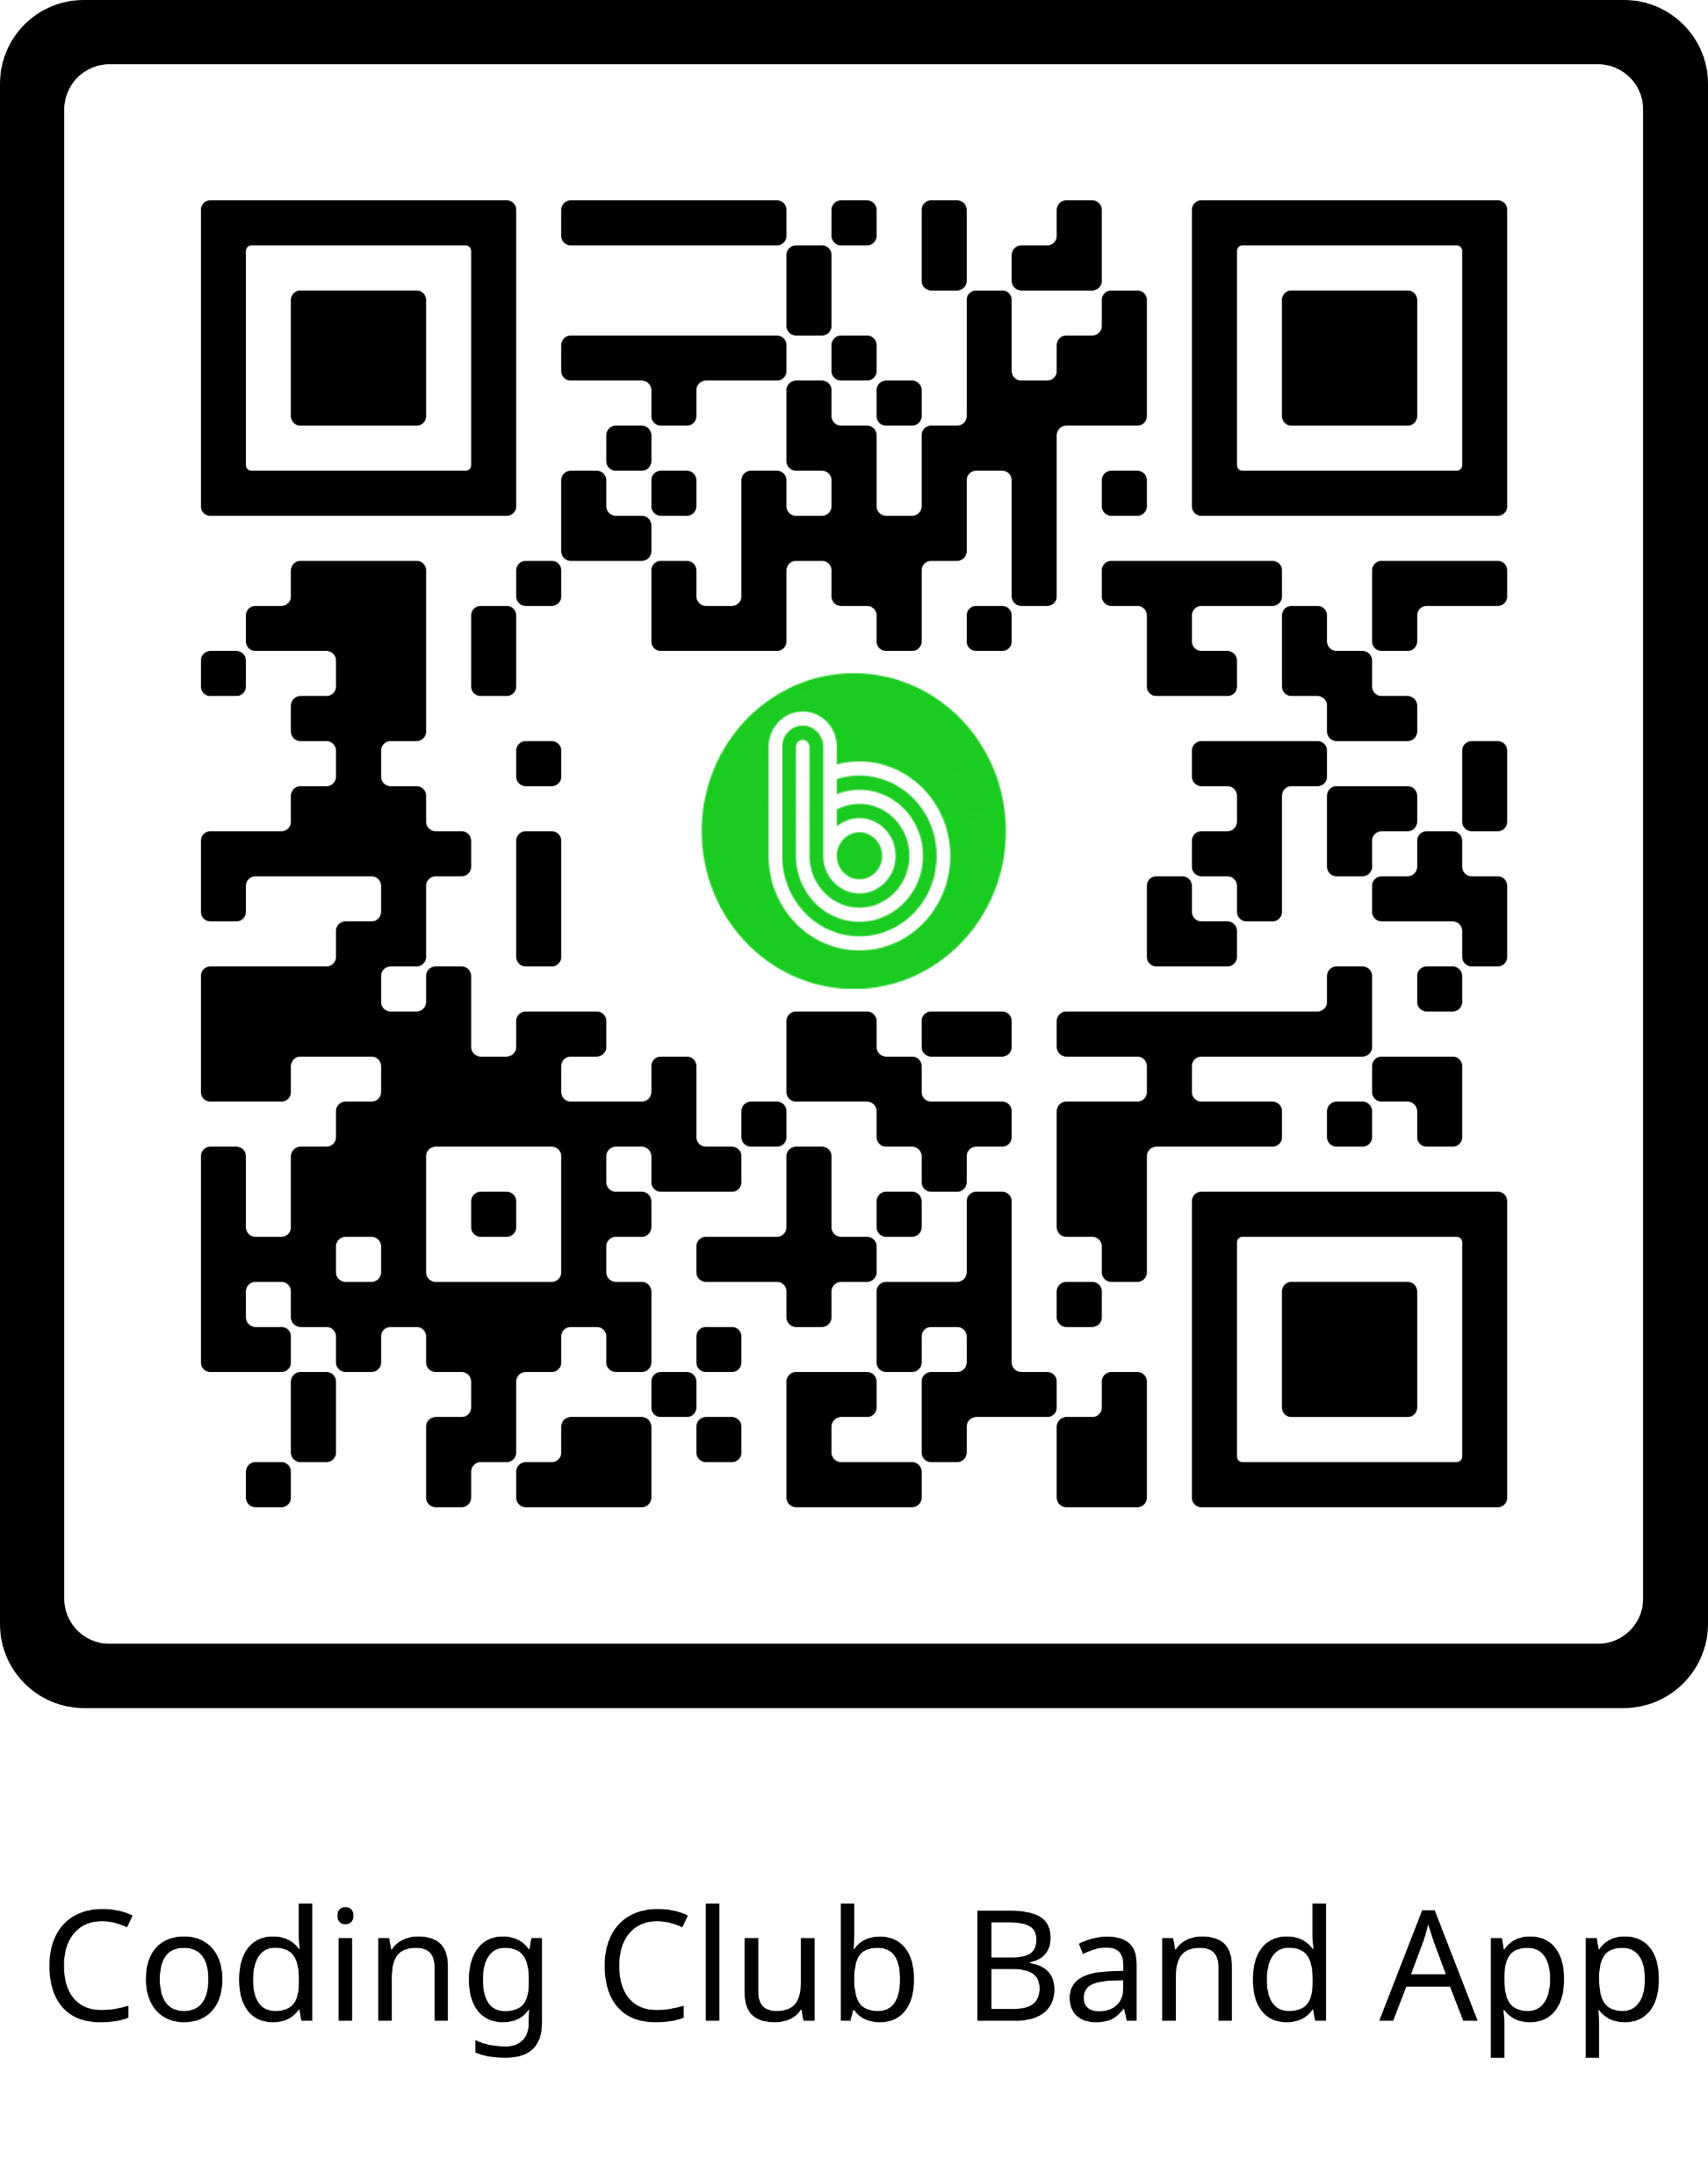

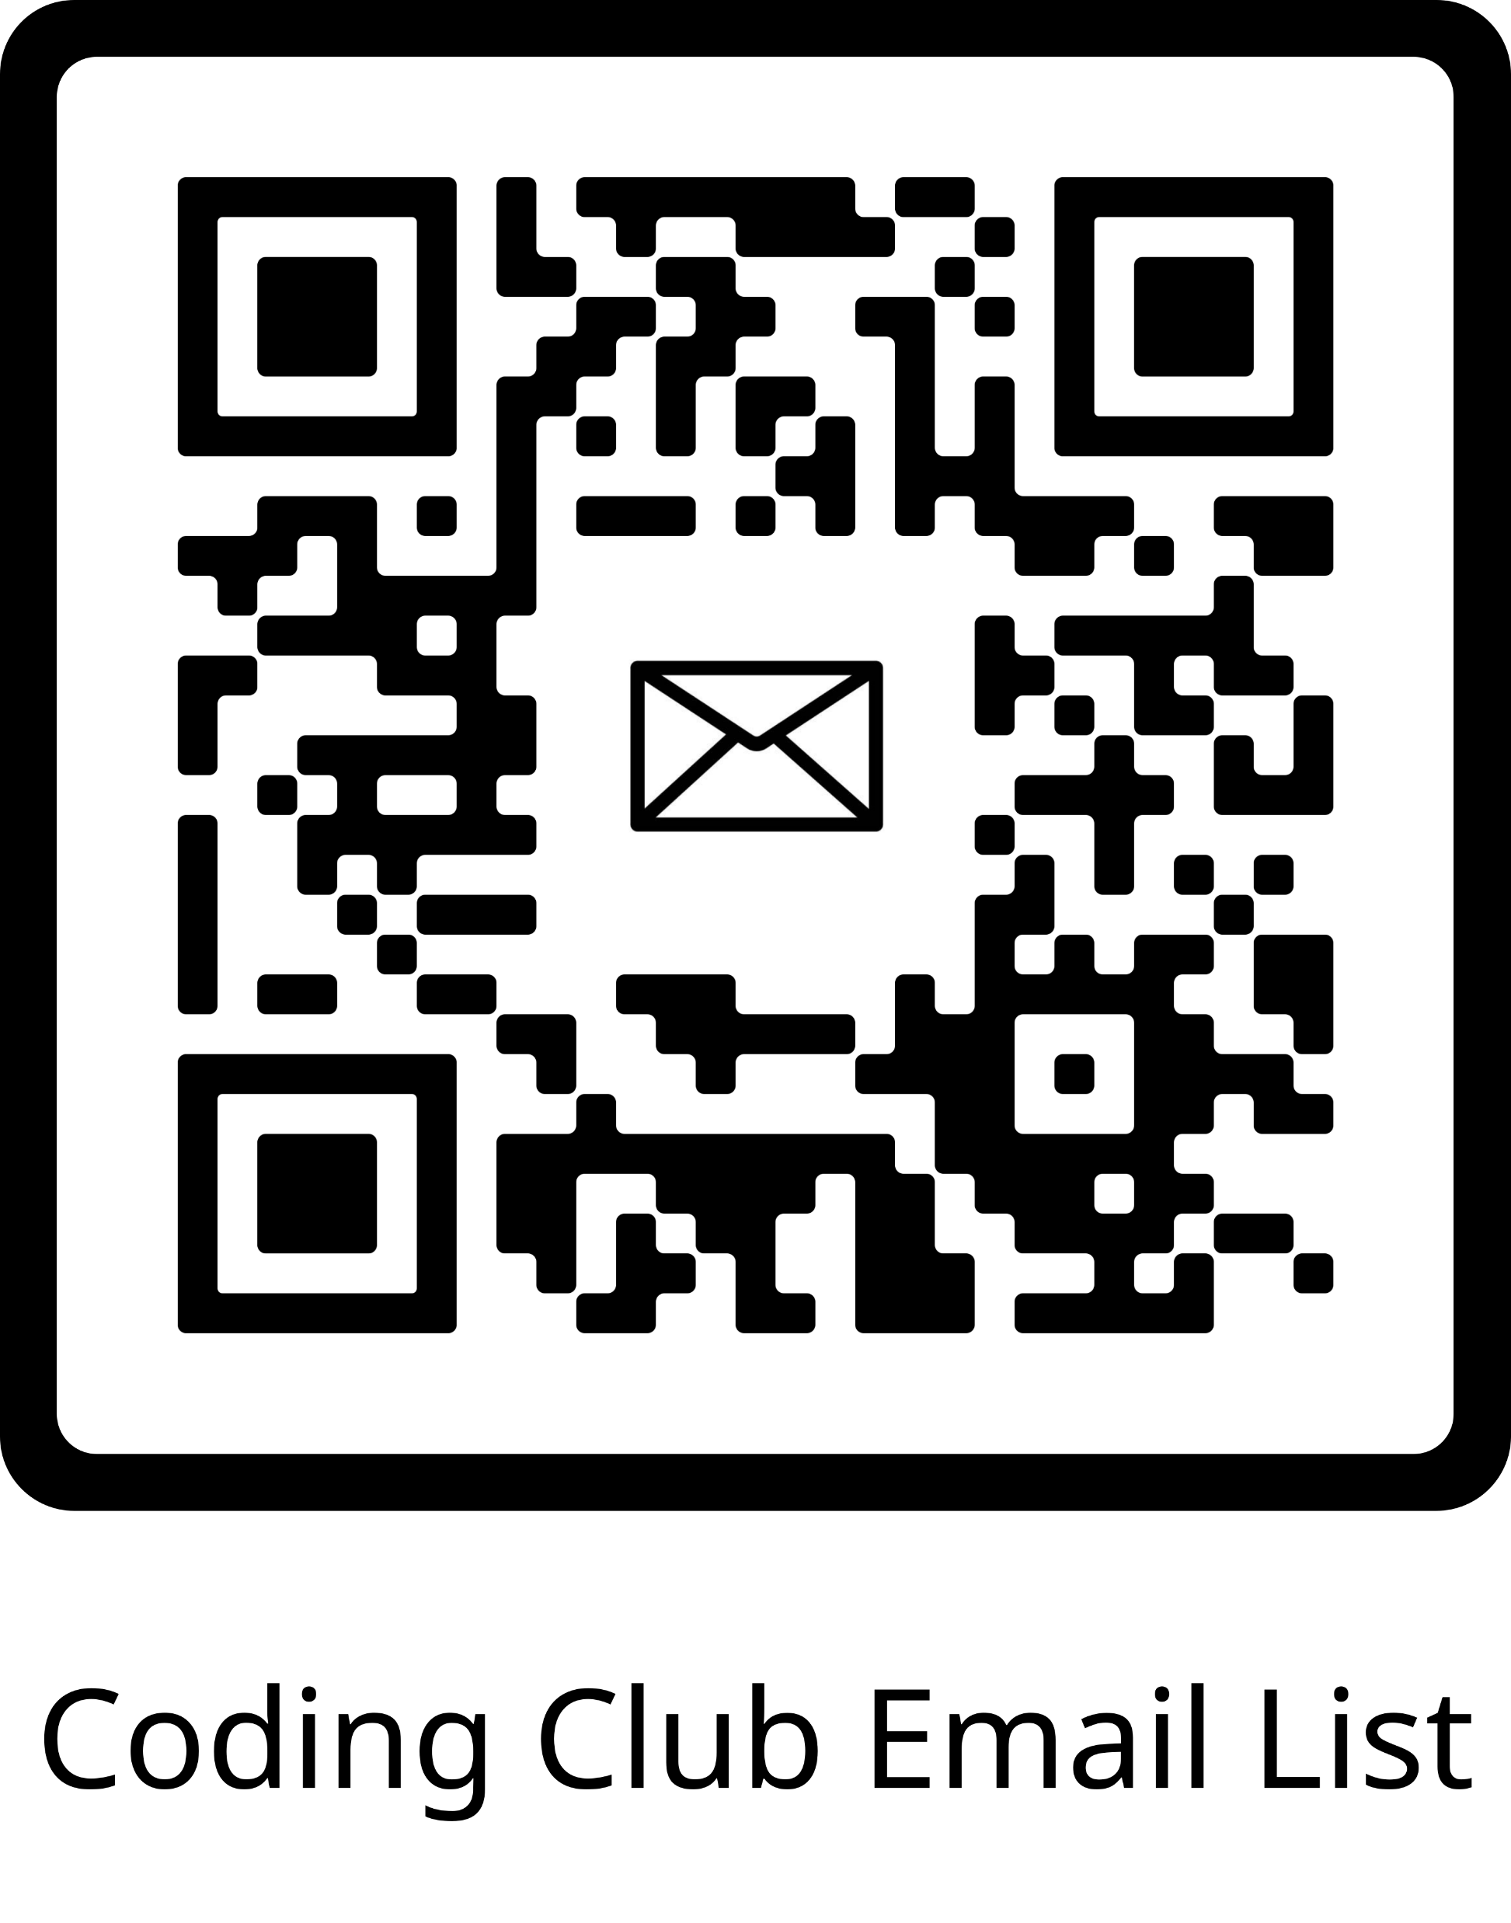
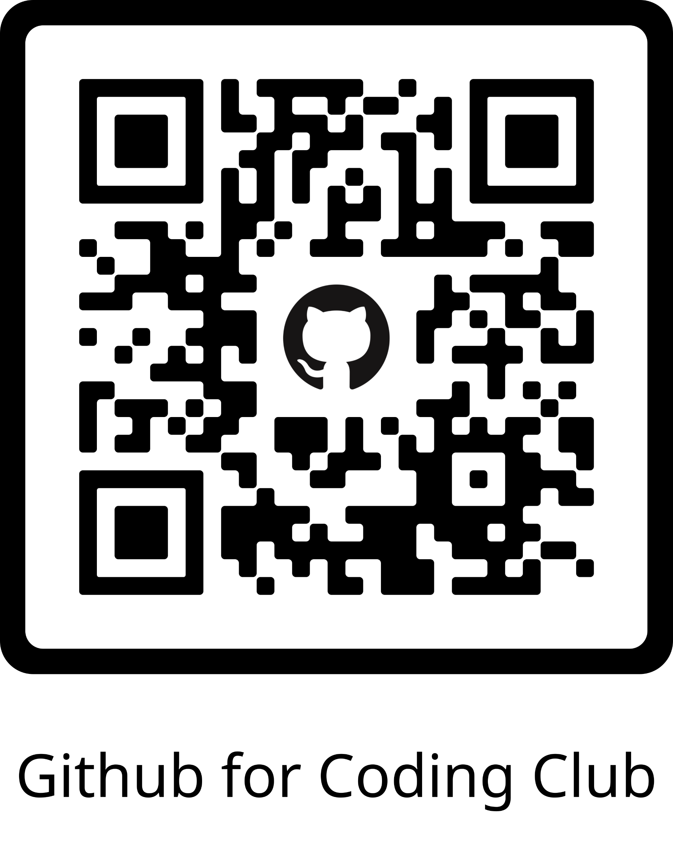
Club Communication
Active Communication:
- Email List: Coding Club Roster 2022-2023.xlsx
Hangout/Direct Messaging (No regular club info sent):
- Discord: https://discord.gg/KpaEqEpV
- Band: https://band.us/n/adaa7budn7g2N

